Slide 1
LEAD SCORING CASE STUDY
BY
-NIKHIL KUMAR SINGH

Slide 2
PROBLEM STATEMENT
An education company named X Education sells online courses to industry professionals. On any given day, many professionals who are interested in the courses land on their website and browse for courses.
The company markets its courses on several websites and search engines like Google. Once these people land on the website, they might browse the courses or fill up a form for the course or watch some videos. When these people fill up a form providing their email address or phone number, they are classified to be a lead. Moreover, the company also gets leads through past referrals. Once these leads are acquired, employees from the sales team start making calls, writing emails, etc. Through this process, some of the leads get converted while most do not. The typical lead conversion rate at X education is around 30%.
Now, although X Education gets a lot of leads, its lead conversion rate is very poor. For example, if, say, they acquire 100 leads in a day, only about 30 of them are converted. To make this process more efficient, the company wishes to identify the most potential leads, also known as ‘Hot Leads’. If they successfully identify this set of leads, the lead conversion rate should go up as the sales team will now be focusing more on communicating with the potential leads rather than making calls to everyone.
X Education has appointed you to help them select the most promising leads, i.e. the leads that are most likely to convert into paying customers.

Slide 3
THE STEPS WE FOLLOW IN THIS EXERCISE ARE AS FOLLOWS:
READING & UNDERSTANDING THE DATA.
HANDLING MISSING VALUES.
TREATING OUTLIERS & IMBALANCE DATA.
VISUALISING THE DATA.
DATA PREPRATION(mapping & dummy variables).
SPLITTING INTO TRAIN-TEST SET(dividing into X & y).
RESCALING.
BUILDING A LINEAR MODEL (using RFE & statsmodel & checking VIF also).
PLOTTING ROC CURVE.
FINDING OPTIMAL CUTOFF POINT.
PRECISION & RECALL (precision_recall_curve).
PREDICTION & EVALUATION ON TEST-SET.

Slide 4
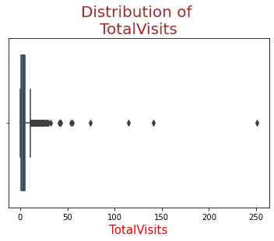
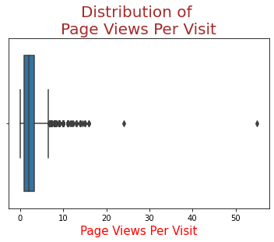
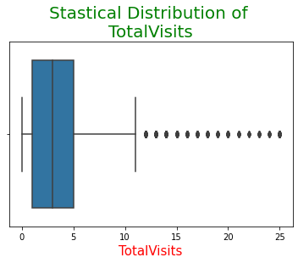
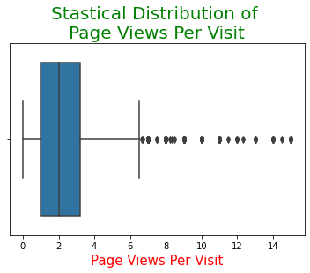
AFTER HANDLING OUTLIERS

Slide 5
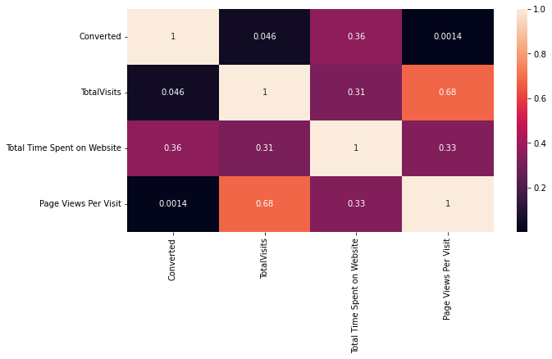
HEAT MAP FOR CORRELATION OF NUMERICAL VARIABLES
TOTAL VISITS & PAGE VIEWS PER VISIT ARE POSITIVELY CORRELATED (0.68).
CONVERTED IS POSITIVELY CORRELATED TO TOTAL TIME SPENT ON WEBSITE (0.36).

Slide 6
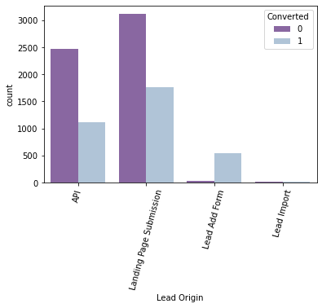
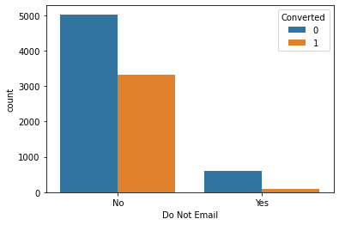
VISUALIZING VARIABLES W.R.T CONVERTED
MOST OF THE LEADS DON’T WANT TO BE EMAILED ABOUT THE COURSE
API & LANDING PAGE SUBMISSION BRING HIGHER NUMBER OF LEADS COUNT BUT THERE CONVERSION RATE IS LESS.
CONVERSION RATE OF LEAD ADD FORM IS HIGH BUT THE NUMBER OF COUNT IS LESS.
LEAD IMPORT ARE VERY VERY LESS IN COUNT.

Slide 7
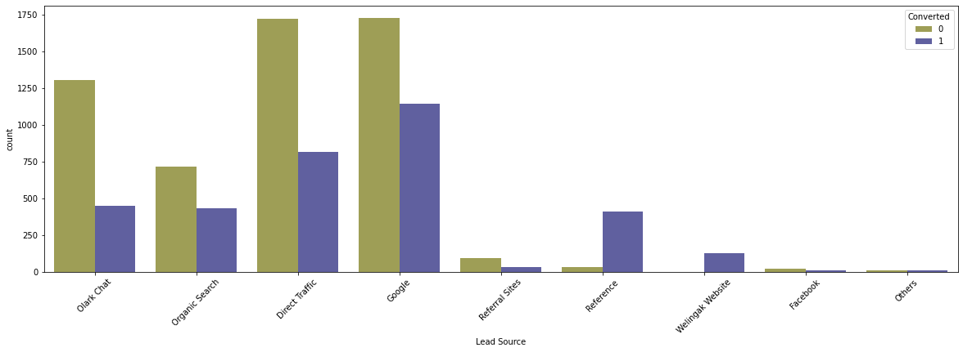
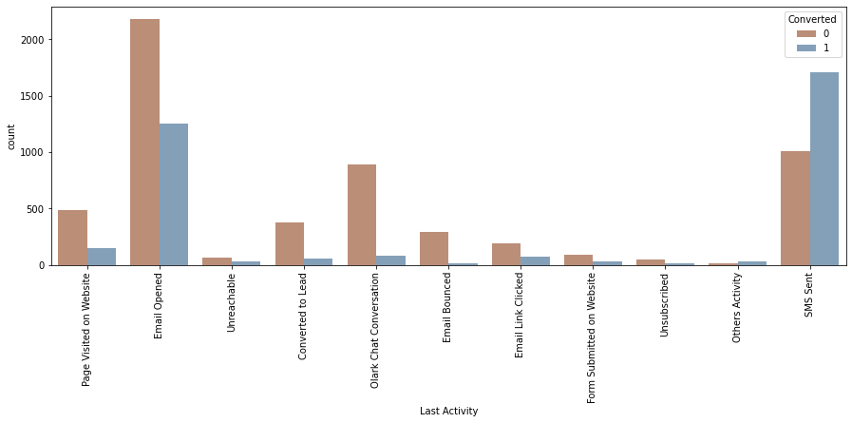
GOOGLE & DIRECT TRAFFIC GENERATES MAXIMUM NUMBER OF LEADS.
CONVERSION RATE OF REFERENCE & WELINGAK WEBSITE IS HIGH.
CONVERSION RATE FOR LEADS WITH THERE LAST ACTIVITY AS SMS SENT IS HIGH.
MOST OF THE LEADS HAVE THERE EMAIL OPENED IN THERE LAST ACTIVITY.

Slide 8
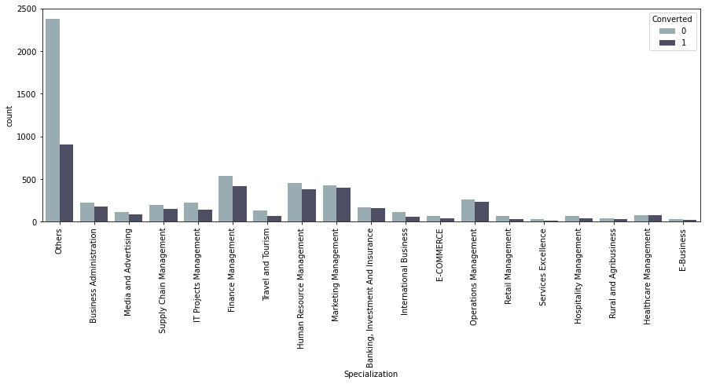
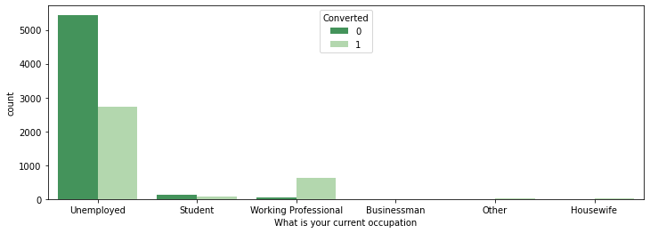
NON-CONVERSION RATE IS MORE THAN CONVERSION RATE IN EVERY SPECIALISATION.
OTHER's CATEGORY SPECIALISATION(maybe student's or someone else) HAS MAXIMUM CONVERTED LEADS.
UNEMPLOYED LEADS ARE THE MOST IN NUMBERS BUT THERE CONVERSION RATE IS HALF THE NUMBER OF LEADS.
WORKING PROFESSIONAL HAVE HIGH CHANCES OF JOINING THE COURSE AS THERE CONVERSION RATE IS GOOD.

Slide 9
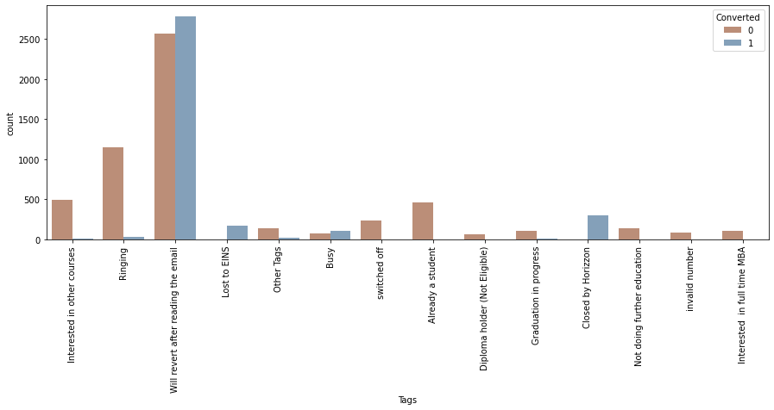
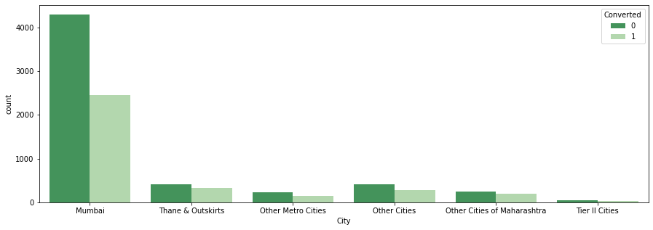
WILL REVERT AFTER READING THE EMAIL HAS MAXIMUM NUMBER OF LEADS COUNT & IT's CONVERSION RATE IS ALSO GOOD.
CLOSED BY HORIZON & LOST TO EINS HAS GOOD CONVERSION RATE BUT THERE NUMBER OF COUNT IS NOT GOOD.
MOST LEADS ARE FROM MUMBAI.
CONVERSION RATE OF ALL THE CITY ARE LESS.

Slide 10
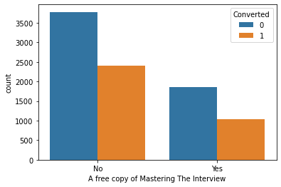
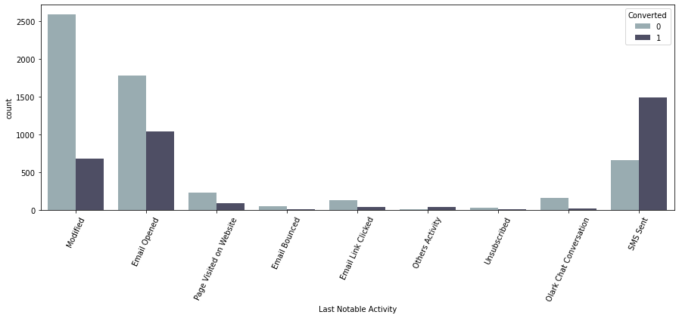
THE PATTERNS LOOK EXACTLY THE SAME FOR BOTH YES & NO, BUT THE COUNT OF NO’s ARE MORE.
NO INFERENCE CAN BE DRAWN FROM THIS.
CONVERSION RATE FOR LEADS WITH THERE LAST NOTABLE ACTIVITY AS SMS SENT IS HIGH.
MOST OF THE LEADS HAVE MODIFIED & HAVE THERE EMAIL OPENED IN THERE LAST NOTABLE ACTIVITY.

Slide 11
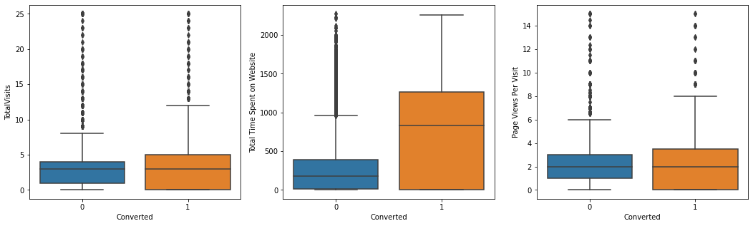
VISUALISING THE NUMERICAL VARIABLES
LEADS SPENDING MORE TIME ON THE WEBSITE ARE MORE LIKELY TO BE CONVERTED.
MEDIANS FOR CONVERTED & NOT-CONVERTED OF TOTAL VISITS & PAGE VIEWS PER VISIT ARE SAME.

Slide 12
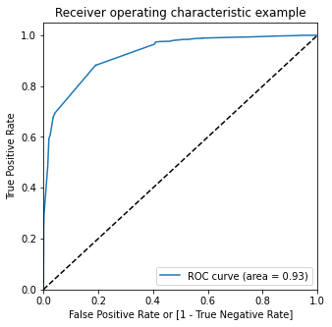
ROC CURVE
It shows the tradeoff between sensitivity and specificity (any increase in sensitivity will be accompanied by a decrease in specificity).
The closer the curve follows the left-hand border and then the top border of the ROC space, the more accurate the test.
The closer the curve comes to the 45-degree diagonal of the ROC space, the less accurate the test.

Slide 13
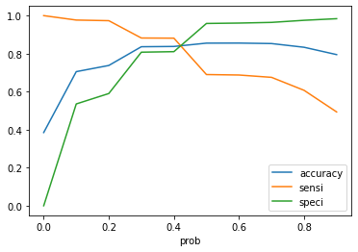
OPTIMAL CUT OFF POINT
POINT WHERE WE GET BALANCED SENSITIVITY AND SPECIFICITY.
IN THIS CASE IT IS 0.42.

Slide 14
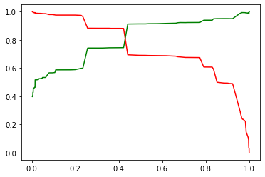
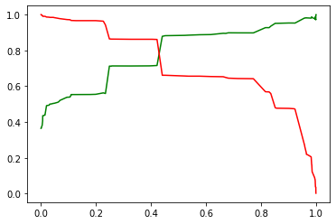
PRECISION RECALL CURVE
TRAINING DATA
TESTING DATA
THE PRECISION RECALL CURVE FOR BOTH TRAINING DATA AND TESTING DATA ARE EXACTLY THE SAME.
THE FINAL PREDICTION OF CONVERSION HAVE A TARGET RATE OF 86%, WHICH IS MORE THAN EXPECTED(80%).

Slide 15
COMPARING ACCURACY, SENSITIVITY, SPECIFICITY, PRECISION & RECALL SCORE OF TRAIN & TEST SET
Train-set accuracy score : 0.8379782711384034 Test-set accuracy score : 0.8255600440690415
Train-set sensitivity : 0.8810302534750614 Test-set sensitivity : 0.8614762386248737
Train-set specificity : 0.81101152368758 Test-set specificity : 0.8050749711649365
Train-set precision score : 0.7449014863463532 Test-set precision score : 0.7159663865546219
Train-set recall score : 0.8810302534750614 Test-set recall score : 0.8614762386248737

Slide 16
CONCLUSION
THE VARIABLES THAT MATTERS MOST ARE :-
TOTAL TIME THEY SPENT ON WEBSITE.
TOTAL NUMBER OF VISITS.
WHEN THE LEAD SOURCE WAS :-
GOOGLE
DIRECT TRAFFIC
REFERENCE
WELINGAK WEBSITE
WHETHER THERE CURRENT OCCUPATION IS WORKING PROFESSIONAL OR IF THEY ARE UNEMPLOYED.
WHEN THE LEAD ORIGIN IS LEAD ADD FORM.
WHEN LAST ACTIVITY WAS :-
SMS SENT
EMAIL OPENED.
WHEN TAGS WAS :-
CLOSED BY HORIZZON
LOST TO EINS.

